Slide 1
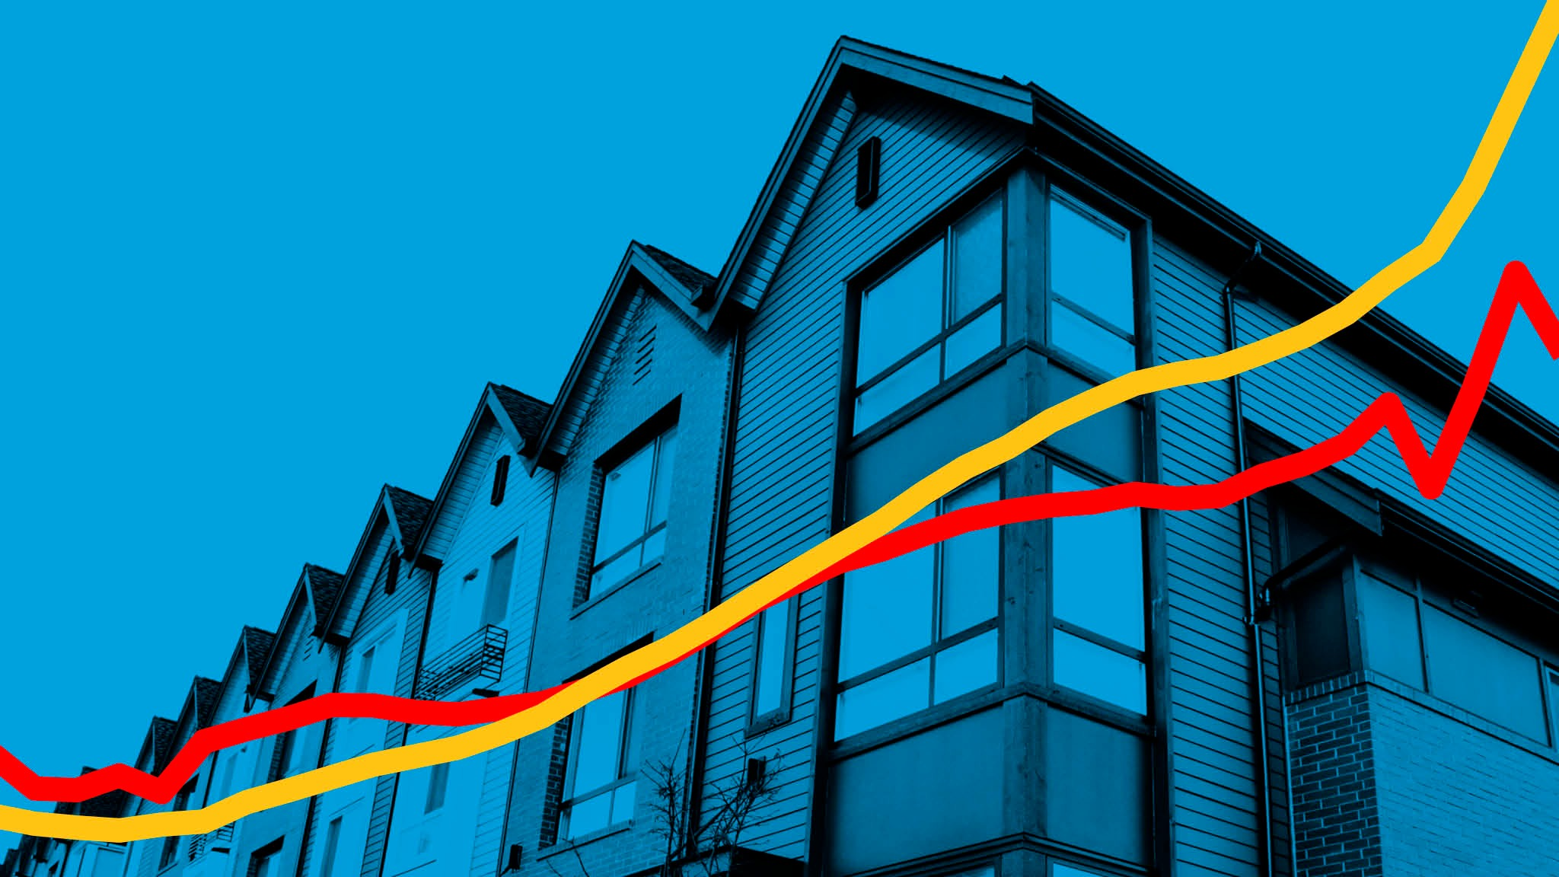
Birmingham Housing price prediction model
Sarah aray
Makaran muhidin
Simon stevens
Nawaz khan
Notes:
SARAH

Slide 2

Background
Create a Machine Learning Model that can predict House Prices in the city of Birmingham, UK.
Based on specific features about the area and the houses in general.
Notes:
SARAH Based on data gathered from the UK's Government Website, the Department for Levelling Up, Housing & Communities API, The Transport for West Midlands API, and The Police API. We wanted to create a Machine Learning Model that is able to predict House Prices in the city of Birmingham, UK; based on certain features, such as crime rate, housing features, schools around the area, and easy access to transportation.

Slide 3





About the Data
Notes:
SARAHThe data was gathered from the UK's Government Website, the Department for Levelling Up, Housing & Communities API, The Transport for West Midlands API, and The Police API.

Slide 4



Data Collection and Feature Engineering
We used Jupyter Notebook and Pandas to call different APIs, and create a data set that was suitable for the model. Taking into consideration the feautures we found the most relevant:
Crime Rates
Transportation
Property Types
Schools in the area
Postcode
Notes:
SARAH

Slide 5
DATA SETS
School location Data
Ofstead
Data
House pricing Data
Crime rate Data
Bus Route Data
Combined Data
ETL phase and linkage of datasets
Notes:
NAWAZ

Slide 6
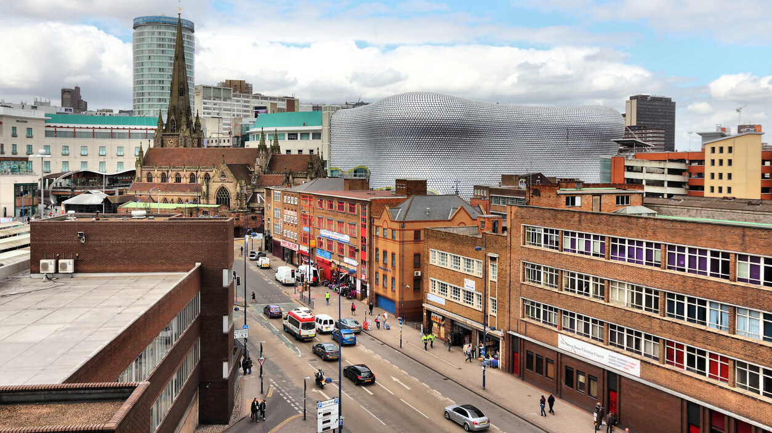
Postcode as a feature
When deciding on location being a feature for our model, we considered ‘postcode selection’ or address-based discrimination.
Our model uses postcodes as a prediction variable for prices solely.
•However, in other fields, such as data for employment, schooling or policing, the use of postcode as a feature can in fact be discriminatory
Notes:
SARAH

Slide 7
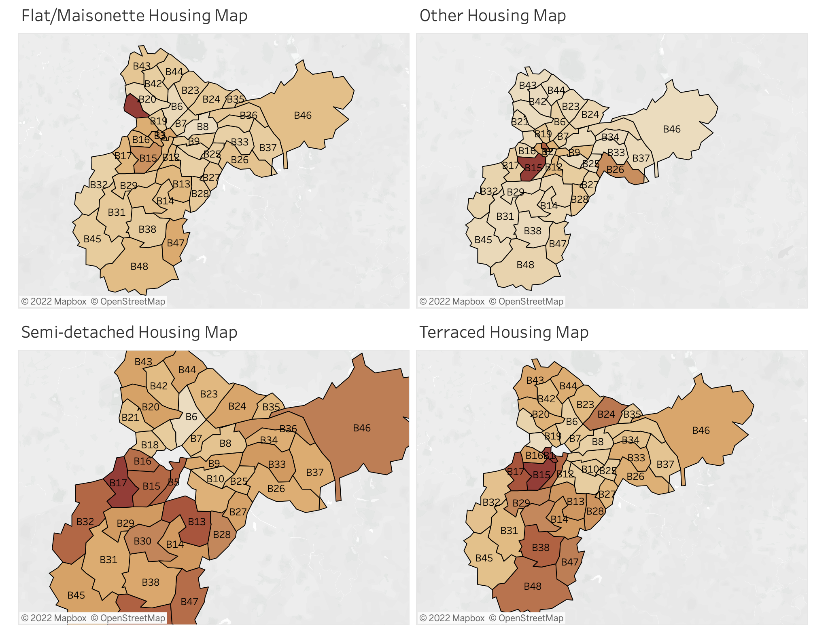
Data Visualisation using Tableau
https://public.tableau.com/shared/85JZW3QTT?:display_count=n&:origin=viz_share_link
Notes:
SARAH

Slide 8

Software and Libraries Used
This project uses the following software and Python libraries:
Python
NumPy
pandas
scikit-learn
Notes:
SARAH

Slide 9



Machine Learning Models
Random Forest Classifier
a classification algorithm consisting of many decisions trees.
Logistic Regression
It estimates probabilities using a logistic regression equation.
Ideal for when the variable being predicted for is a probability on a binary range from 0 to 1.
Ideal for data sets with more complexity and randomness
Notes:
MAKARAN

Slide 10

Machine Learning Models
Linear Regression Analysis
Is used to predict the value of a variable based on the value of another variable.
The variable you are using to predict the other variable's value is called the(features) independent variable.
The variable you want to predict is called the (price) dependent variable.
Notes:
MAKARAN

Slide 11

Hypothesis and Predictions
Random forest tends to be the ideal candidate for estimating datasets that are more longitudinal in nature with more complexity and randomness, and usually scaling and preprocessing the data does not affect its results, so our guess is it will perform better in this case.
Notes:
SIMON

Slide 12
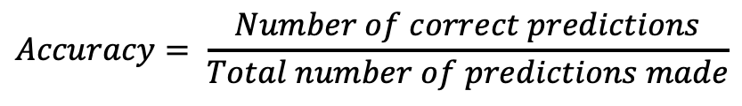
Use of accuracy as a measure
There are various metrics to evaluate an algorith in ML:
Classification Accuracy
Logarithmic Loss
Confusion Matrix
Area under Curve
F1 Score
Mean Absolute Error
Mean Squared Error
We used classification accuracy in our case as we have equal number of samples belonging to each class.
If samples were disproportional, it could give a false sense of achieving high accuracy.
$$Accuracy= \frac{Number of correct predictions}{Total number of predictions made}$$
Notes:
SARAH Accuracy is the ratio of number of correct predictions to the total number of input samples.

Slide 13
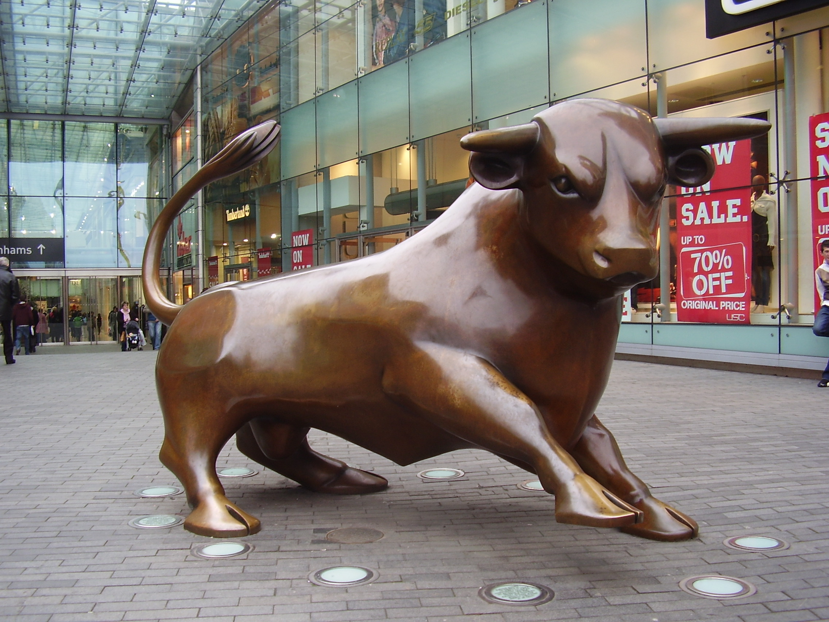
FINAL SCORES UNSCALED
LOGISTIC REGRESSION
Train: 47%
RANDOM FOREST CLASSIFIER
Train: 54%
Test: 45%
Test: 38%
Notes:
MAKARAN

Slide 14
FINAL SCORES SCALED
LOGISTIC REGRESSION
Train: 47%
RANDOM FOREST CLASSIFIER
Train: 54%
Test: 44%
Test: 38%
Notes:
MAKARAN

Slide 15

Conclusion
Unlike our hypothesis suggested, Logistic Regression perfomed better than RFC.
However, the scores were unaffected by scaling.
We did not produce feature optimisation, so further features could be added.
The model runs well, but accuracy levels could be improved.
Notes:
NAWAZ

Slide 16

Further Considerations
Datasets
Most Up to date
Features
Severity of features
Greater ranger
ID trends
Data set incorporating more house data (No. Rooms, square meters) features.
School data may be affecting our model as this is dependent on school’s performance and as our analysis has IDed high house price is not connected with school performance.
Bus routes maybe more frequent around the city center and this may be affecting our model.
Notes:
SIMON

Slide 17

Further Considerations
Optimization
Different Models.
Factors that affect house prices?
There are a multitude of factors in predicting house prices, many being qualitative and not just quantative.
Notes:
SIMON

Slide 18
Any Questions?
https://github.com/saraharayr/housing-price-predictor.git

